Slide 1
Copysets: Reducing the Frequency of Data Loss in Cloud Storage
Adviser: Gwan-Hwan Hwang
Student: Wei-Chih Chien
NTNU CSIE CClab

Slide 2
Author: A. Cidon, S. Rumble, R. Stutsman, S. Katti, J. Ousterhout, and M. Rosenblum, Standford University Source: 2013 USENIX Annual Technical Conference (Awarded Best Student Paper)
https://www.usenix.org/conference/atc13/technical-sessions/presentation/cidon

Slide 3
Outline
Introduction
Intuition
Design
Related Work
Conclusion

Slide 4
Random Replication
Widely used in data center storage systems to prevent data loss.
Hadoop Distributed File System (HDFS)
RAMCloud (https://ramcloud.stanford.edu)
Google File System (GFS)
Windows Azure
However, large-scale correlated failures such as cluster power outages handled poorly by random replication. *
This stresses the availability of the system.
* R. J. Chansler. Data Availability and Durability with the Hadoop Distributed File System.
J. Dean. Evolution and future directions of large-scale storage and computation systems at Google.
D. Ford et al. Availability in globally distributed storage systems.
K. Shvachko et al. The hadoop distributed file system.

Slide 5
Copysets Replication
Split node into copysets
Replicas of single chunk can only be stored on one copyset.
Data loss events occur only when all the nodes of some copyset fail simultaneously.
Decrease the probability of data loss under power outages.

Slide 6
Outline
Introduction
Intuition
Design
Related Work
Conclusion

Slide 7
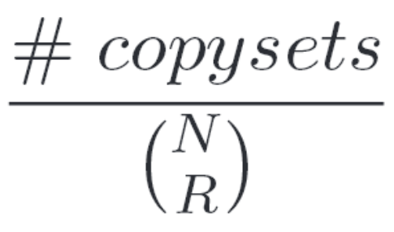
Probability of data loss
N : # nodes in the system
R : # replicas of each chunk
Example :
{1, 2, 3}, {4, 5, 6}, {7, 8, 9}
N = 9 R = 3
# copysets = 3

Slide 8
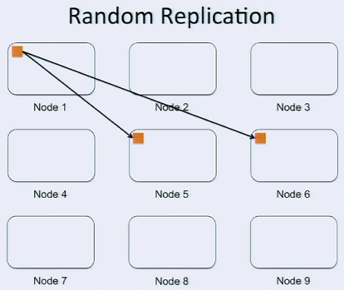
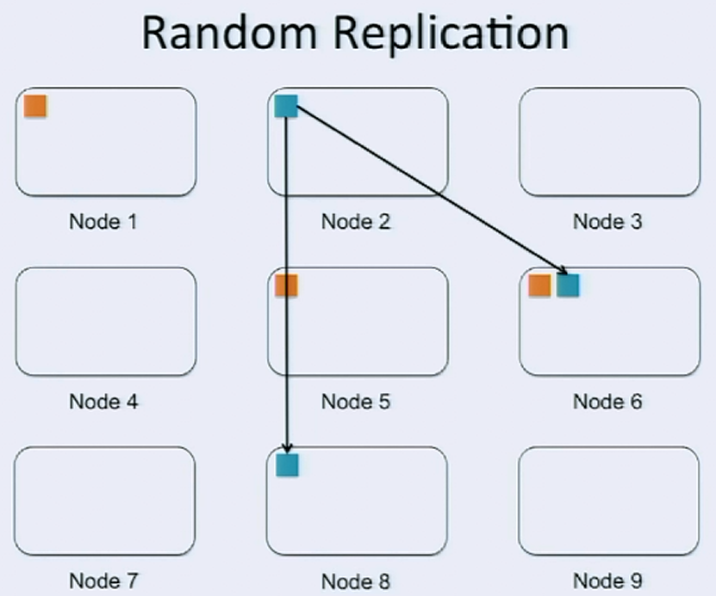

Slide 9
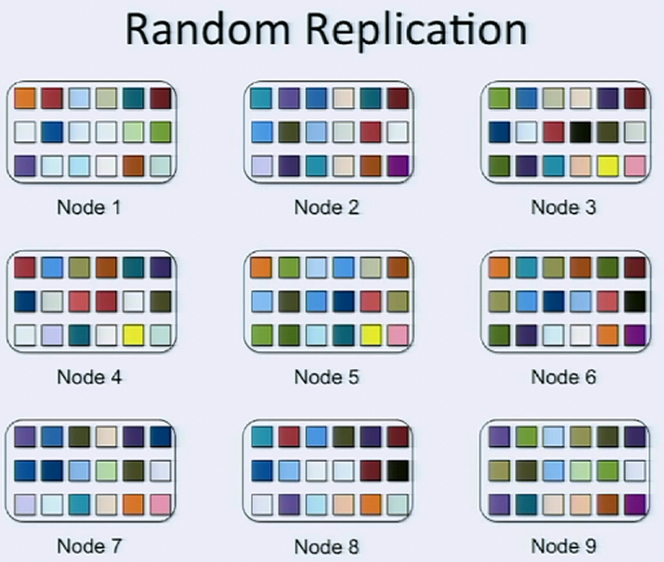
{1, 5, 6}
{2, 6, 8}
{3, 4, 5}
…
{5, 6, 9}

Slide 10
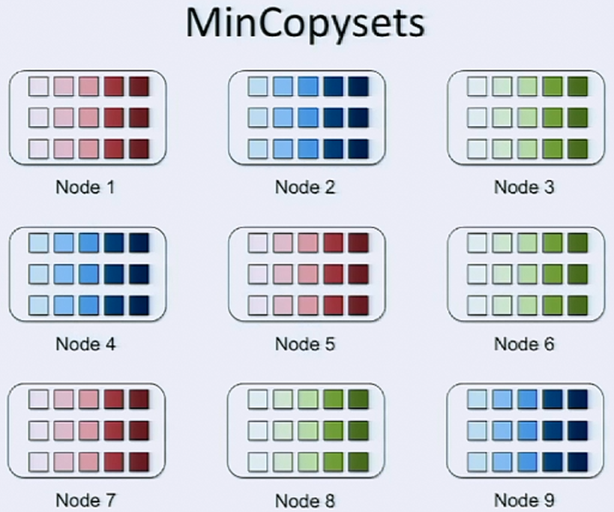
{1, 5, 7}
{2, 4, 9}
{3, 6, 8}

Slide 11
Probability of data loss
N : # nodes in the system
R : # replicas of each chunk
Example :
{1, 2, 3}, {4, 5, 6}, {7, 8, 9}
N = 9 R = 3
# copysets = 3

Slide 12
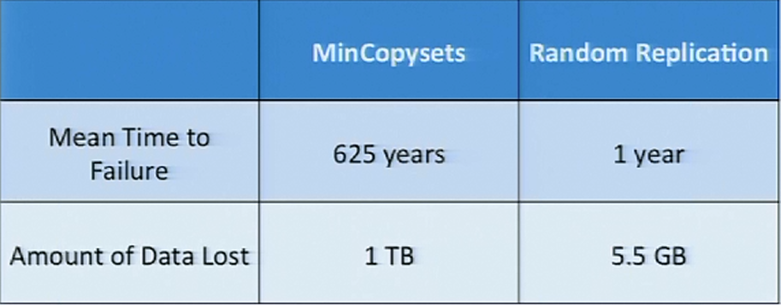
The Trade-off
5000-node cluster

Slide 13
Outline
Introduction
Intuition
Design
Related Work
Conclusion

Slide 14
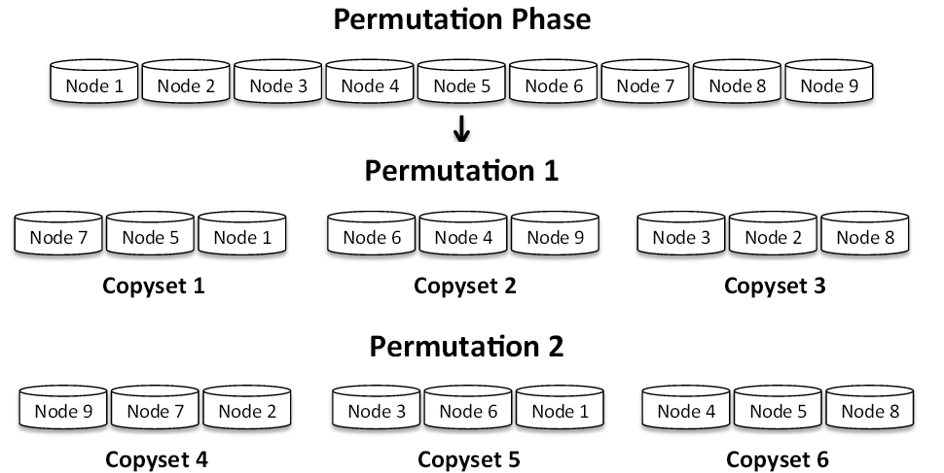
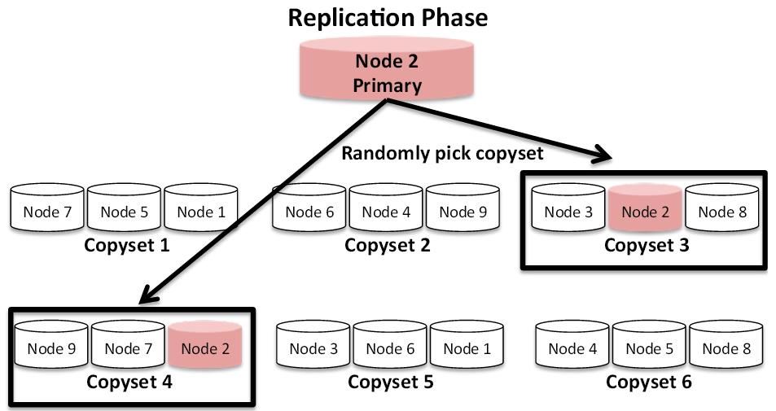
Design
2 phases : Permutation & Replication.
Scatter width : # nodes that store copies for each node’s data.

Slide 15
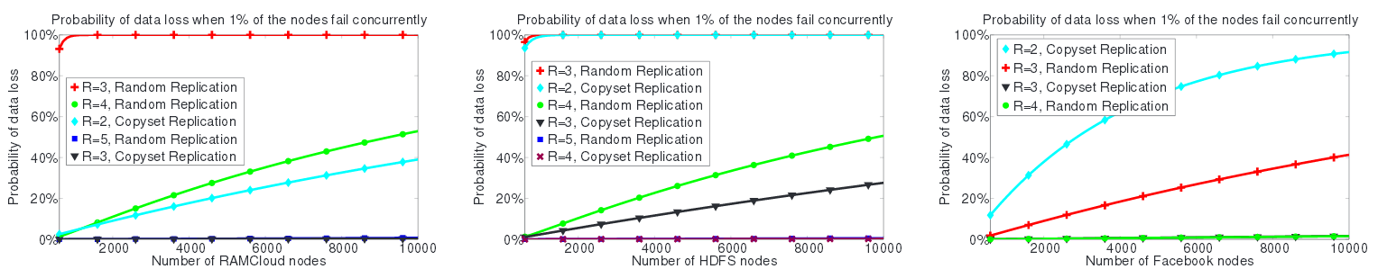
Data loss probability of random replication and Copyset Replication in different systems.

Slide 16
Outline
Introduction
Intuition
Design
Related Work
Conclusion

Slide 17
Related Work
BIBD. (Balanced Incomplete Block Designs) [Fisher, ’40]
Power downs. [Harnik et al ‘09, Leverich et al ‘10, Thereska ‘11]
Multi-fabric interconnects. [Mehra, ’99]

Slide 18
Outline
Introduction
Intuition
Design
Related Work
Conclusion

Slide 19
Conclusion
Many Storage systems randomly spray their data across a large number of nodes.
Serious problem with correlated failures.
Copyset Replication is a better way of spraying data that decreases the probability of correlated failures.

Slide 20

Thank You for Your Listening

